Slide 1
Lecture 11
Experimental Design and Research Ethics

Slide 2
Review
1 What is the difference between an observational study and an experiment?
An experiment assigns the treatments, and settles who gets which by chance; an observational study only records groups that already exist. The test is whether the study created the groups or found them.
2 What is a lurking variable?
A variable associated with both the explanatory and the response variable, which can make two things look related when neither causes the other.
3 What does it mean for a study to be blinded, and what makes it double blind?
Blinded: the subjects do not know which treatment they received. Double blind: the people measuring the response do not know either.

Slide 3
A placebo surgery
Arthroscopic knee surgery for osteoarthritis was one of the most common operations in the United States, and patients said it helped.
Moseley and colleagues (2002) enrolled 180 patients with knee osteoarthritis at the Houston VA Medical Center and assigned each of them at random to one of three groups: arthroscopic debridement, arthroscopic lavage, or placebo surgery - skin incisions and a simulated procedure, with no arthroscope inserted.
Neither the patients nor the staff who later measured their pain and function knew which group a patient was in. Every patient was followed for two years.
What kind of study is this, and what is it about the design that lets it answer the question?
A completely randomized, double blind experiment.
Three treatments assigned at random, one of them a placebo; double blind because both the patients and the assessors were kept unaware of who got which. Over two years neither surgery group did better than the placebo group on pain or function - the benefit patients felt came from believing they had been treated. Without a placebo arm and blinding, nobody would have known.
Source: Moseley et al. (2002), New England Journal of Medicine

Slide 4
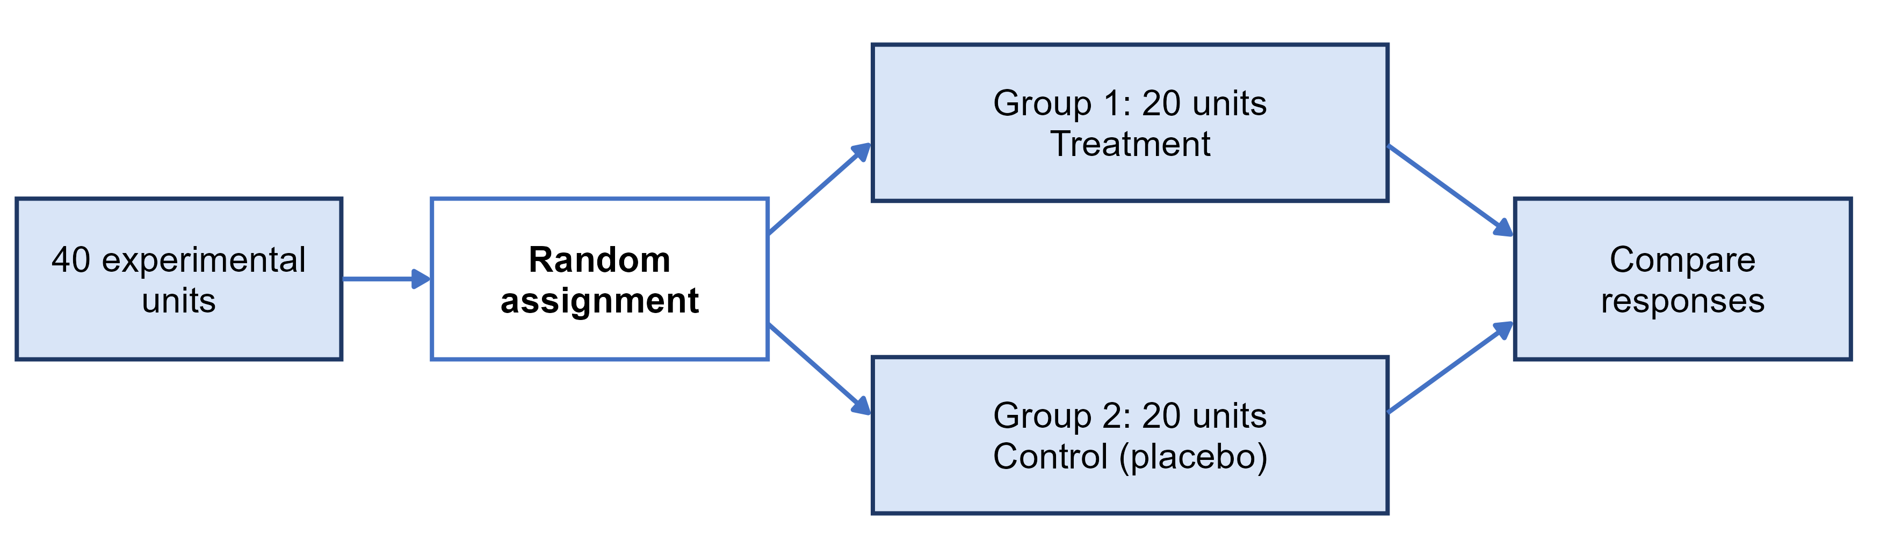
Completely randomized design
completely randomized design
every unit is assigned to a treatment completely at random - the simplest design
The Pfizer-BioNTech vaccine trial was a completely randomized design with two groups

Slide 5
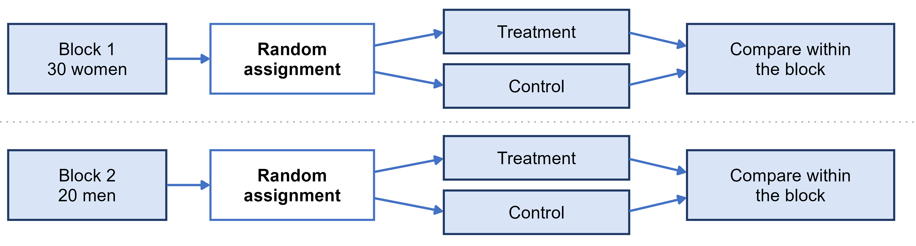
Randomized block design
block
a group of units that are alike in a way that affects the response, formed BEFORE treatments are assigned
randomized block design
randomize treatments separately inside each block, then compare treatments within blocks
blocking is to experiments what stratifying is to sampling

Slide 6
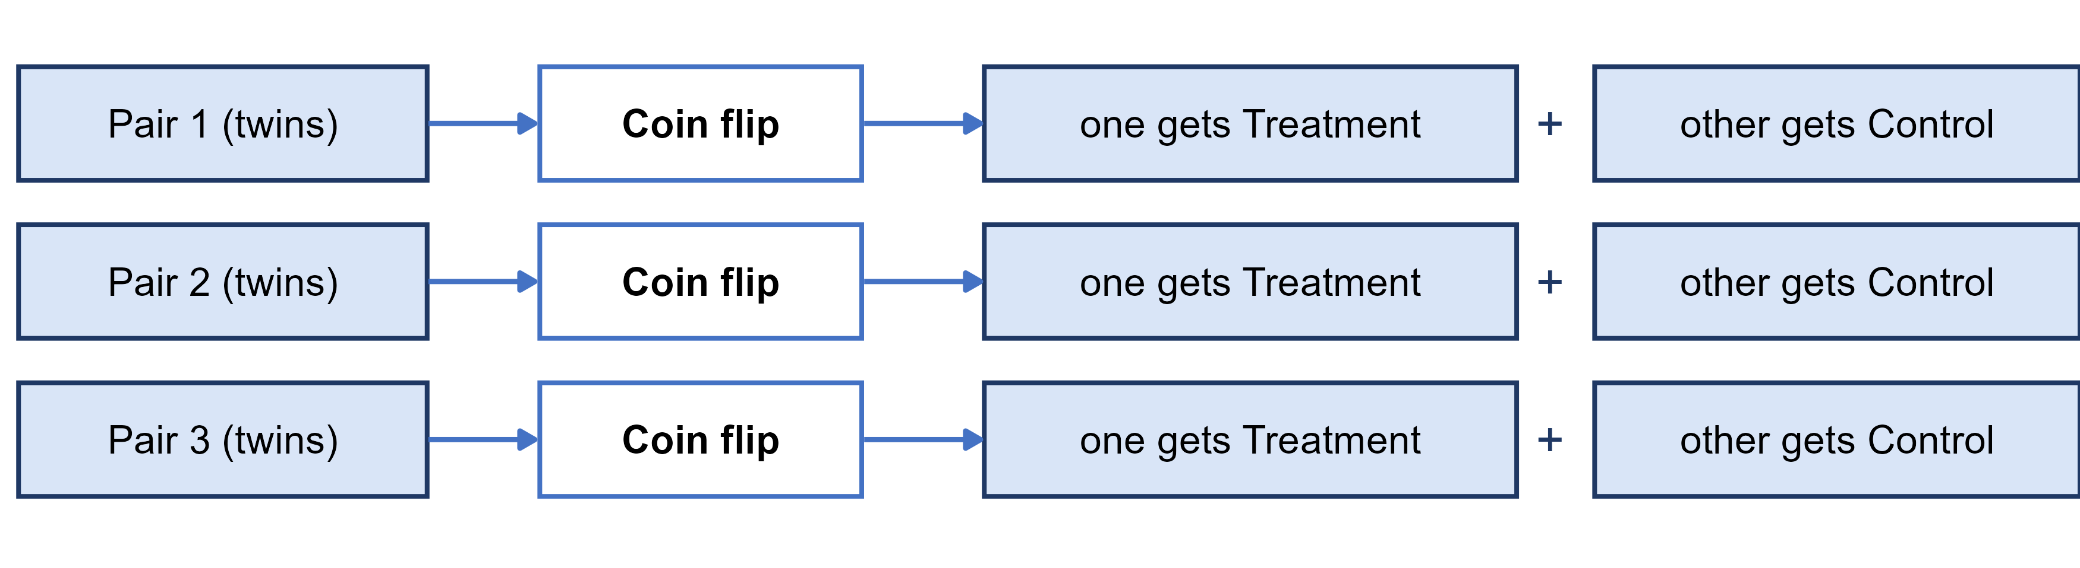
Matched pairs design
matched pairs design
a block design where every block is a pair of very similar units, and a coin flip decides which one gets each treatment
or each subject is their own pair, receiving both treatments in a random order
Before-and-after data with no random order or control group is much weaker evidence

Slide 7
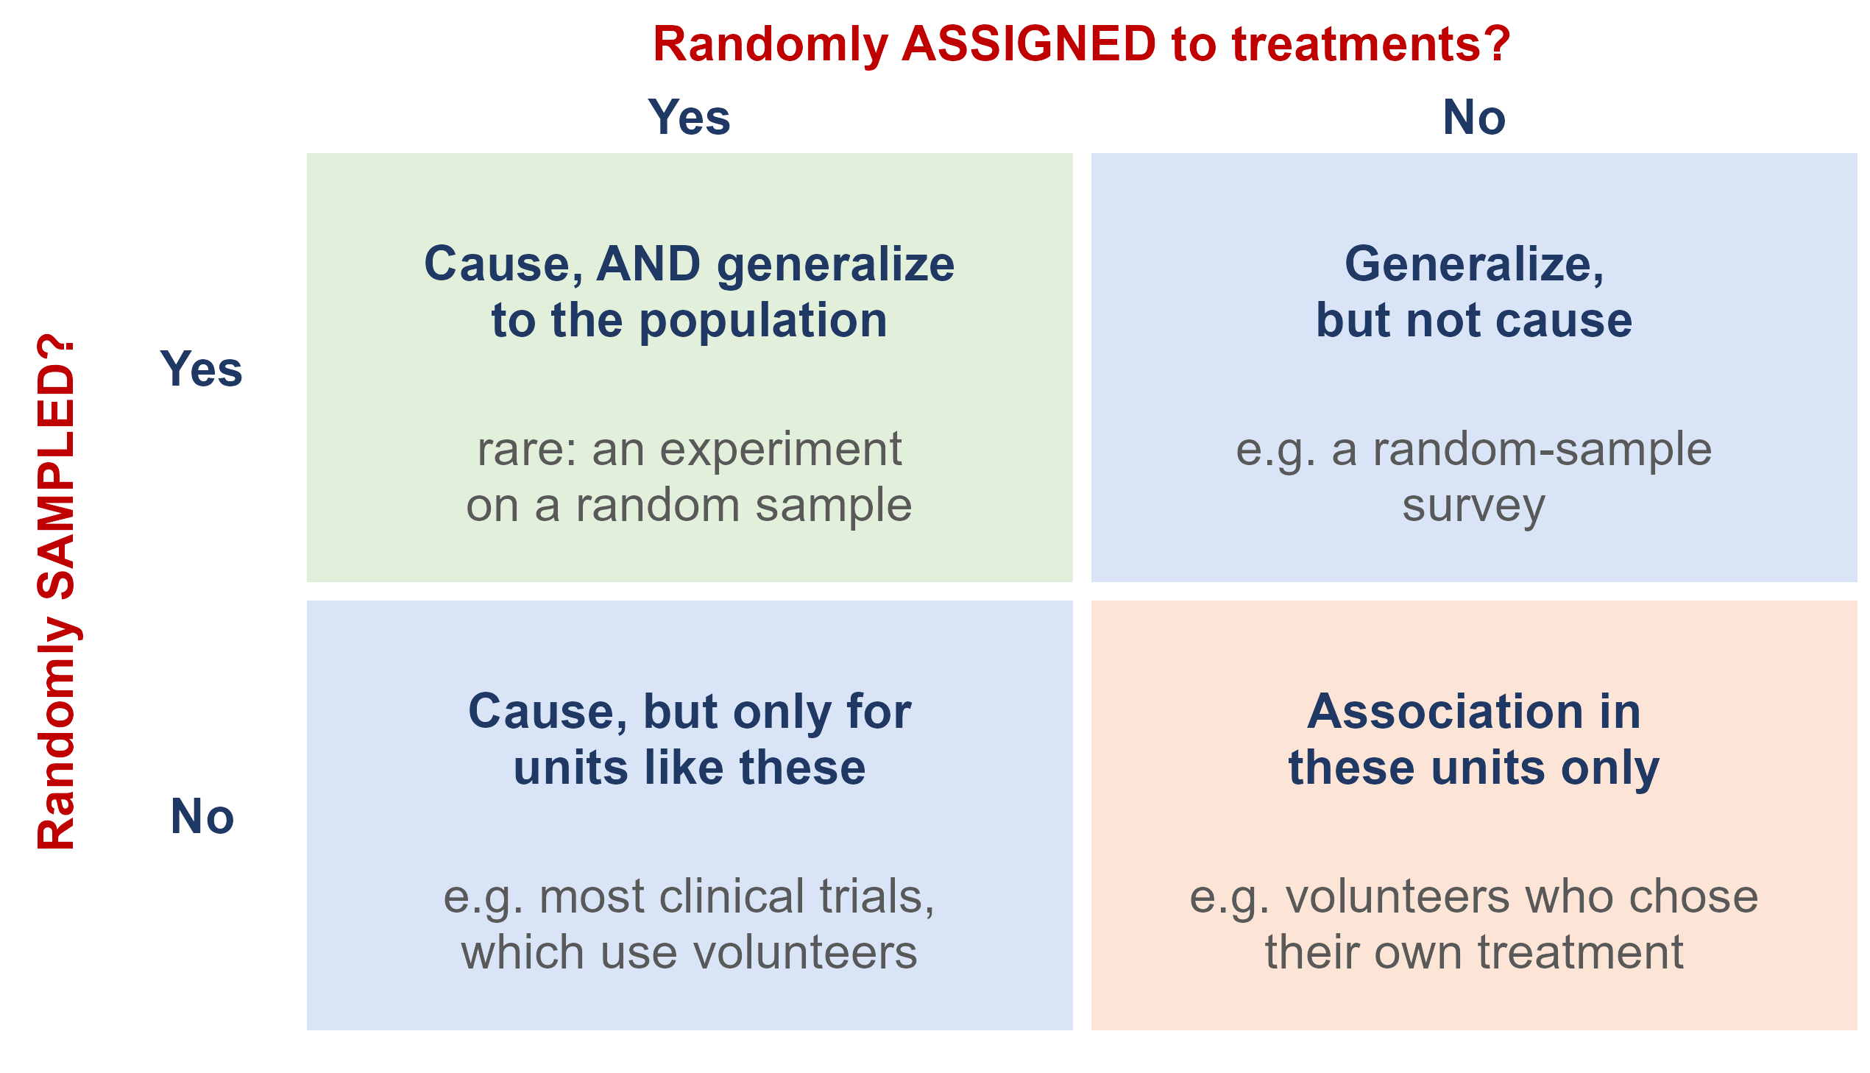
What does randomization buy you?
Random sampling lets you generalize from the sample to the population
Random assignment lets you conclude cause and effect
Most studies have only one. A trial on volunteers shows a vaccine works - for people like those volunteers

Slide 8
Was the placebo surgery trial ethical?
Patients in the placebo arm were anaesthetised and cut open with no chance of benefit. How was that allowed?
Every patient signed a consent form stating explicitly that they might receive placebo surgery and that it would do nothing for their arthritis, and an institutional review board approved the trial.
Why was it acceptable to withhold an operation that was already standard care?
Because nobody actually knew it worked. It was being performed very widely on the strength of what patients reported, with no randomized evidence behind it. When experts are genuinely uncertain, a trial is justified - that uncertainty is called equipoise.
So, was it ethical?
On balance most would say yes: real informed consent, board approval, genuine uncertainty, and a small risk set against an answer that changed practice for hundreds of thousands of people. Sham surgery is still debated, and every such trial is judged case by case.

Slide 9
Ethics: the Facebook experiment
For one week in January 2012, Facebook ran a completely randomized experiment on 689,003 users: each was assigned at random to a News Feed with fewer positive posts, with fewer negative posts, or left unchanged as a control. The results were published in 2014. The users never knew.
1. Facebook said agreeing to its Data Use Policy counted as informed consent. Do you agree?
The journal did not: its Expression of Concern said the study may not have met the principles of informed consent and the chance to opt out.
2. Why did no ethics board stop it?
Facebook, a private company, was not bound by the federal rules. Cornell's board decided its researcher was not directly involved, so it did no review.
3. What is the lesson?
Clicking I agree on a terms-of-service page is not informed consent - even for a well-designed experiment.
Sources: Kramer, Guillory and Hancock (2014), PNAS; PNAS Editorial Expression of Concern (2014)

Slide 10
The Belmont Report: three principles
Why the rules exist: in the U.S. Public Health Service syphilis study at Tuskegee (1932 to 1972), about 600 Black men in Macon County, Alabama - some 400 of them with syphilis - were told they were being treated for "bad blood". They were never told their diagnosis, and were not offered penicillin even after it became the standard cure in the late 1940s.
The study ran for forty years and stopped only when the press exposed it in 1972. Congress responded with the National Research Act of 1974, which created the commission that wrote the Belmont Report in 1979. Its three principles are the foundation of the review boards that approve human-subject research today.
respect for persons
people decide for themselves whether to take part
beneficence
do no harm: maximize the possible benefits and minimize the possible risks
justice
the burdens and benefits of research are shared fairly

Slide 11
Research ethics today
informed consent
subjects are told the purpose, procedures and risks in advance, and can refuse or quit at any time
confidentiality
information about individuals is protected and never released in a form that identifies them
Institutional Review Board (IRB)
reviews and approves studies on human subjects before they start
at UI, through the Office of Research Assurances

Slide 12
Ethics: honest data
Ethics also means honest data. An investigation of the social psychologist Diederik Stapel found he had invented data outright, tainting more than 55 of his papers and 10 PhD dissertations he supervised. But a problem does not have to be that big to matter. A researcher is surveying households in a community. What is wrong with each of these?
1. She picks a block where she already knows a lot of the neighbours.
A convenience sample. It is biased, and presenting it as representative of the community is misleading.
2. Four houses have nobody home. She skips them and never goes back.
Nonresponse. The households she misses are not a random subset - working families are exactly the ones least likely to be home in the daytime.
3. She fills in those four forms with answers copied from the neighbours.
Fabricated data. However small the study, this is never acceptable.
Source: Introductory Statistics 2e (OpenStax), Section 1.4 and Example 1.22

Slide 13
Practice: what design, and can it show cause?
1. A survey finds that people who own dogs have lower blood pressure than people who do not.
Observational - nobody was assigned a dog. Active people may both own dogs and have lower blood pressure.
2. 60 volunteers with insomnia are randomly split: 30 get melatonin, 30 get an identical-looking placebo.
Completely randomized experiment - it can show cause, for people like these volunteers.
3. In each of 4 greenhouses, tomato plants are randomly assigned to fertilizer A or fertilizer B.
Randomized block design, with greenhouses as the blocks - it can show cause.

Slide 14
What you should know: kinds of study
Experimental study
A study in which the units are assigned to treatments by chance rather than by judgement, and the response is then measured. The study creates the groups.
Observational study
A study in which the explanatory and response variables are measured for each unit without trying to influence anything. The groups already exist, through the choices the units made, or through circumstance, and nothing is assigned.
Survey
A study in which units are selected from a population and asked questions, in order to describe that population. A survey is generally a type of observational study - nothing is assigned.

Slide 15
What you should know: sampling designs
Simple random sample (SRS), and systematic sample
SRS: every possible sample of n units is equally likely. Systematic: choose a random starting point, then take every kth unit from the sampling frame.
Stratified random sample, and cluster sample
Stratified: split the population into strata that are alike within, then draw an independent SRS from each one. Cluster: split it into clusters, each a mini-population, then randomly select whole clusters and measure everyone in them. A two-stage cluster sample then samples units inside the chosen clusters instead of taking all of them.
Convenience sample, and voluntary response sample
Convenience: a sample of whoever is easiest to reach. Voluntary response: a sample of people who select themselves by responding. Neither is random, and both are biased no matter how large they get.

Slide 16
What you should know: experimental designs
Completely randomized design
Every experimental unit is assigned to a treatment completely at random. The simplest design.
Randomized block design
Units are first grouped into blocks that are alike in a way expected to affect the response, and the random assignment is then carried out separately within each block. Blocking is to experiments what stratifying is to sampling.
Matched pairs design
A block design in which each block is a pair of very similar units, such as twins or two adjacent plots - or a single subject who receives both treatments in a random order.

Slide 17
What you should know: terminology
The language of an experiment
Experimental units, the factor, its levels, the treatments, the control group, a placebo, blinding and double blinding.
Association is not causation
A lurking variable is associated with both the explanatory and the response variable, and can produce an association where there is no causal link.
The two things randomness buys you
Random sampling lets you generalize to the population. Random assignment lets you claim cause. A bigger sample shrinks sampling error, but it never removes bias.

Slide 18
Which one is further from typical?
So far “far from the center” has been measured in whatever units we happened to be using - points, grams, milligrams. Here are two deviations, each from a different variable:
A student scores 86 on an exam. The class mean was 74 and the standard deviation was 8 points, so she is 12 points above the mean.
Rice Krispies has 290 mg of sodium. Across the twenty cereals from Week 3 the mean was 167 mg and the standard deviation about 77 mg, so it is 123 mg above the mean.
123 is more than ten times 12. Is Rice Krispies ten times as unusual as the student?
No - and as it stands the question has no answer at all.
Points and milligrams are not the same scale, so the two deviations cannot be compared while they still carry their units. Divide each one by the standard deviation of its own variable and they can be: the student is 12 / 8 = 1.5 standard deviations above her mean, and Rice Krispies is 123 / 77 = 1.6 above its own. More than ten times the deviation in raw numbers, and almost exactly the same distance from typical.
So: stop measuring a distance in the original units, and measure it in standard deviations instead.

Slide 19
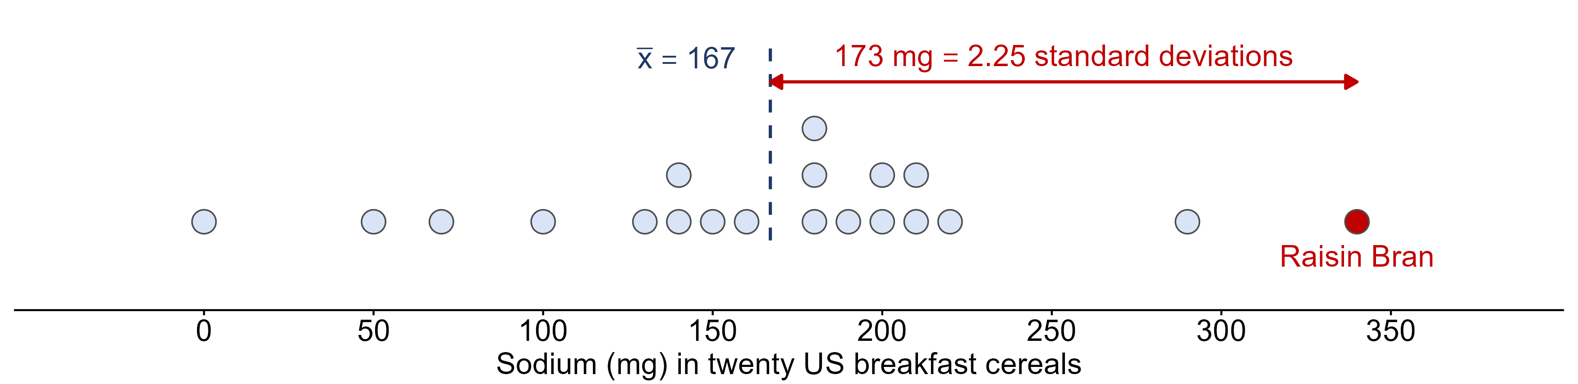
Measuring a deviation in standard deviations
How unusual is Raisin Bran?
340 - 167 = 173 mg above the mean, and s is about 77 mg, so the deviation is 173 / 77 = 2.25 standard deviations. Raisin Bran has far more sodium than most of these cereals.
A deviation divided by the standard deviation is called a z-score: z = (x - x̄) / s
A cereal at z = 2.25 and a student at z = 2.25 are equally unusual within their own distributions, even though one is milligrams and the other is exam points

Slide 20
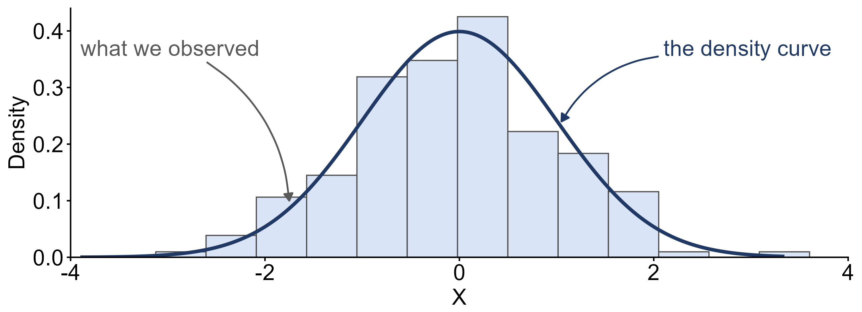
Density curves
density curve
a smooth curve standing for the distribution of a continuous variable in theory, where the height of the curve is a continuous measure of how often values occur nearby
A histogram's bars are counts inside intervals we chose. A continuous variable has no intervals, so in theory its distribution is a curve, not bars.
The bars are the sample we happened to collect; the curve is the distribution behind it

Slide 21
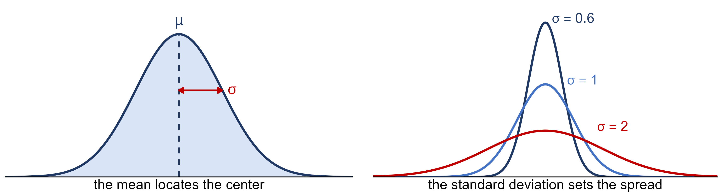
The normal distribution
normal distribution
a family of density curves, all symmetric and bell shaped with the peak at the mean. Two parameters pick one out: the mean μ locates the center, the standard deviation σ sets the spread.
Shorthand: x ~ N(μ, σ). Next class: the empirical rule.
Small σ: tall and narrow. Large σ: short and broad. The center never moves.

